Slide 1



UNIT 2
Lesson 7
IN SYNC WITH YOUR PARENTS
Part 3

Slide 2
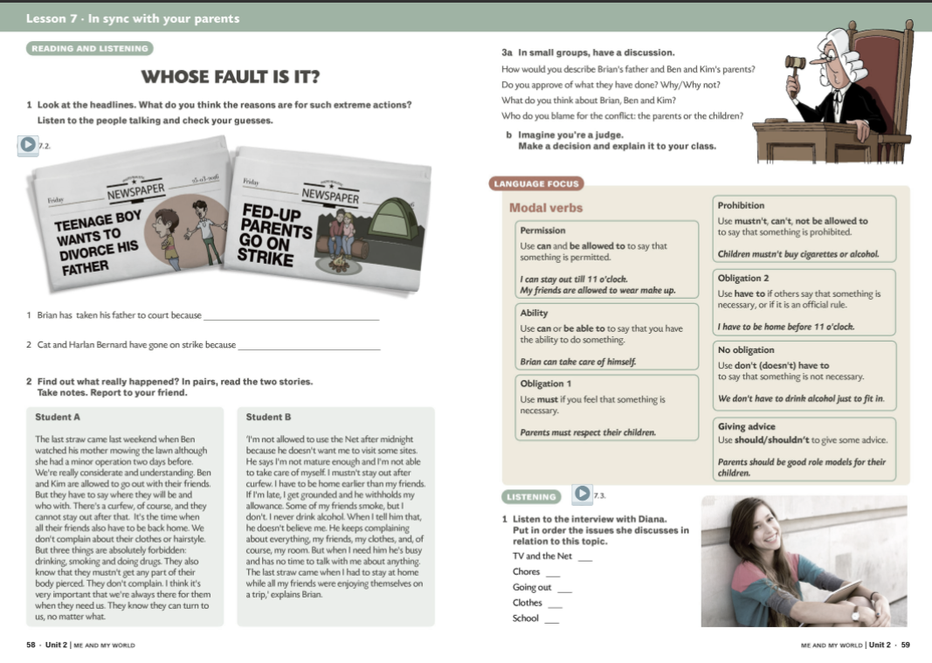
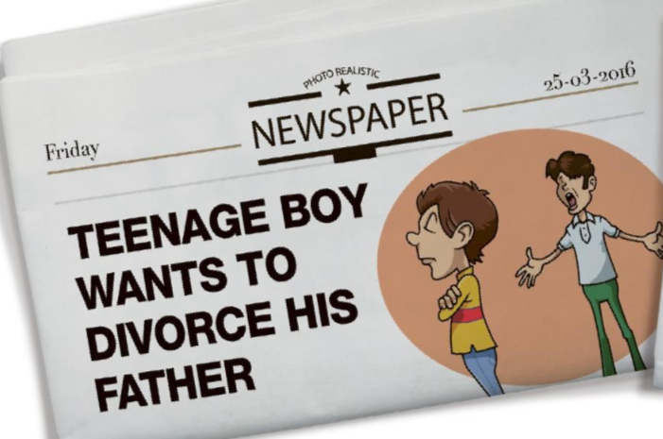

PERMISSION
OBLIGATION
NO OBLIGATION
PROHIBITION
I can...
I’m allowed to...
I have to...
I can... I’m allowed to... I can’t... I have to... I don’t have to... I mustn’t... I’m not allowed to...
I don’t have to...
I’m not allowed to...
I mustn’t...
I can’t...

Slide 3
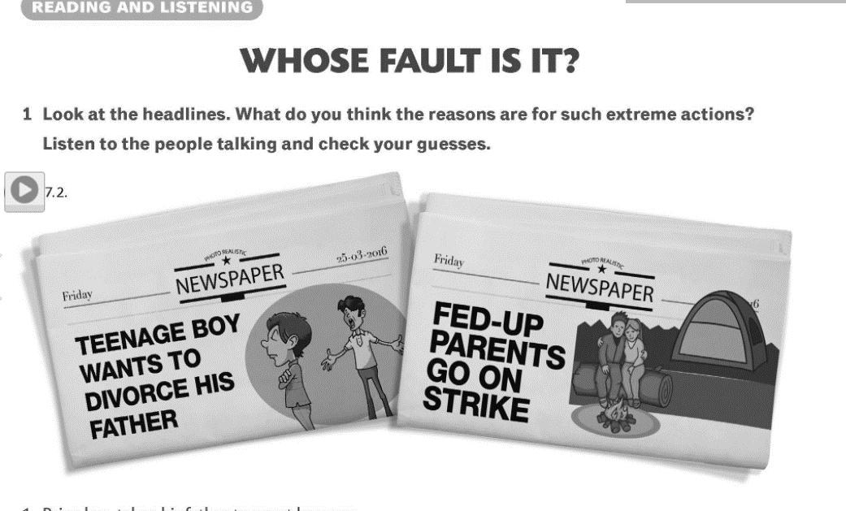

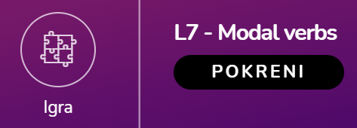
Because his father didn’t let him attend his end-of-school class trip.
Because their children don’t do the chores around the house.

Slide 4
curfew
forbidden
visit a site
mature
be grounded
withhold someone’s allowance
recover from a minor operation
a time, especially at night, when people are not allowed to leave their homes
not allowed by an official rule
go to a website
completely grown or developed
be punished
not give an allowance to someone
get better after an operation which wasn’t very serious

Slide 5

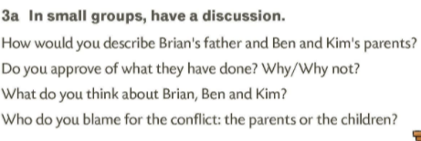
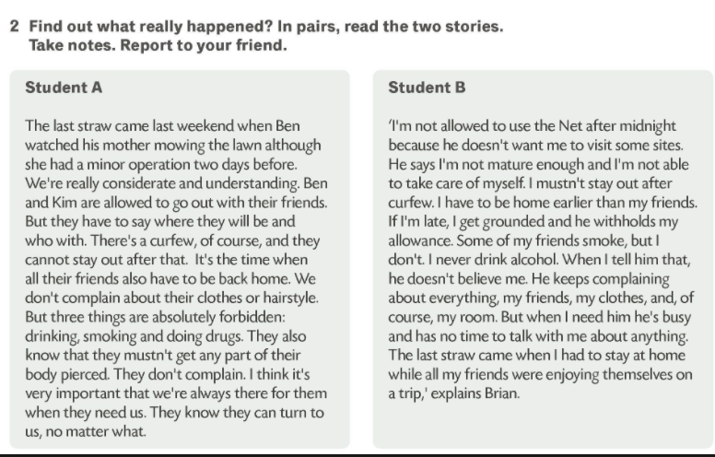
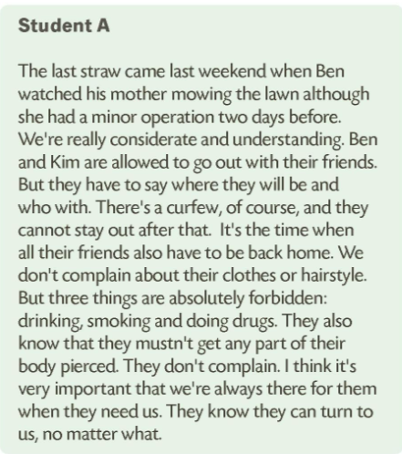
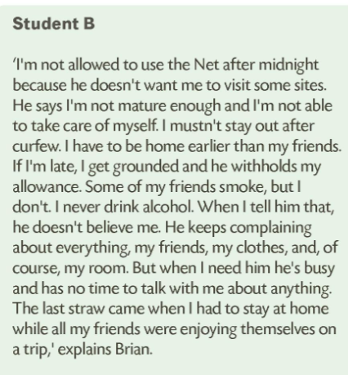

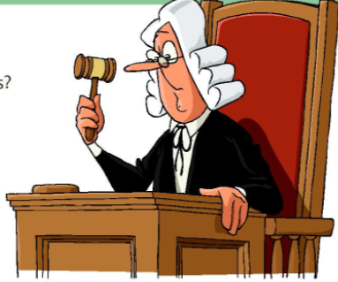

Slide 6
